Slide 1
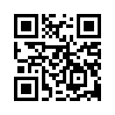
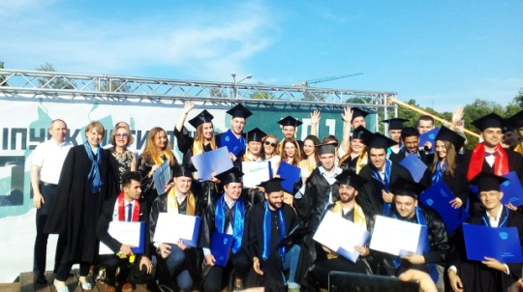
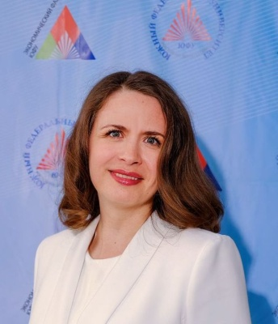
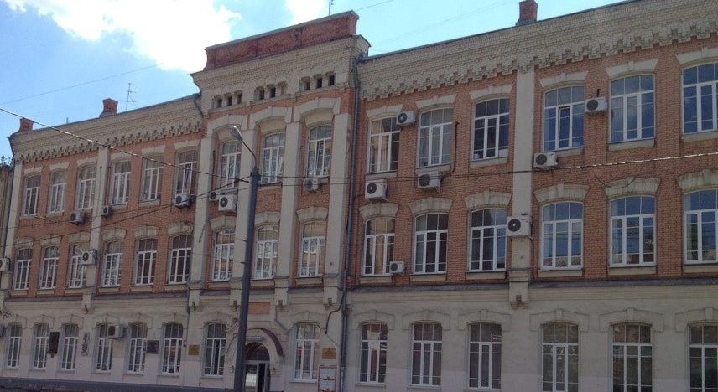
Economics, Management and Law
Master’s degree program in Economics
The program provides an opportunity to obtain a unique interdisciplinary set of competencies that are in demand today and in the future in the labour market
The program is built on the balance of theory and practice
It allows you to gain systematic knowledge in economics and law and acquire the skills to transform them into effective management decisions using analytical methods and digital technologies
Program length and study mode:
2 years, full-time
13 tuition free places
7 contract-based places
Language: Russian
ECTS: 120
Start date: September 2023
Professional modules of disciplines in economics, management and law.
Great opportunities for building an individual learning path
Five professional disciplines in English
Opportunities for academic mobility, scientific research, the involvement of visiting professors and cooperation with industrial partners allow students to gain experience to determine career prospects
Project-based learning technologies and digital skills
Program director Anastasia Nikitaeva
Head of the Department of Information Economics, Doctor of Sciences in Economics, Professor aunikitaeva@sfedu.ru

